Slide 1
What makes a car accident worse?
Hanying Li, Zhouhao Bao, Zhaoyi Zheng,Yuncong Liu
3/8/2024

Slide 2







Project Overview
Crash Score
?
?
?
?
?
?
?
...
Date & Time
Stop Sign
Traffic Light
Weather
Work Area
US HWY
Goal: Identify and interpret the factors that influence the severity of vehicle crashes
Notes:
Our project takes a deep dive into analyzing vehicular crash data.
The overall goal is to identify and interpret factors that relate to a higher or lower Crash_Score.
The target variable Crash_Score combines several factors, such as the number of injuries and fatalities and the number of vehicles involved, which in short represents the severity of vehicle crashes.
A larger crash score indicates a more severe crash.

Slide 3

Dataset
Data Source: Town of Cary, North Carolina
Vehicle crashes that occurred between 2014 and 2018
23137 rows
Target variable: Crash_Score
12 variables including date & time, road conditions, weather, etc.
Crash_Score | year | Month | Time_of_Day | Rd_Feature | Rd_Character | Rd_Class | Rd_Configuration | Rd_Surface | Rd_Conditions | Light | Weather | Traffic_Control | Work_Area
6.56 | 2016 | 6 | 2 | NONE | STRAIGHT-LEVEL | STATE HWY | TWO-WAY-PROTECTED-MEDIAN | SMOOTH ASPHALT | DRY | DAYLIGHT | CLEAR | NONE | NO
6.53 | 2016 | 6 | 3 | NONE | STRAIGHT-LEVEL | OTHER | TWO-WAY-NO-MEDIAN | COARSE ASPHALT | DRY | DAYLIGHT | CLEAR | NONE | NO
1.58 | 2016 | 6 | 5 | NONE | STRAIGHT-LEVEL | STATE HWY | TWO-WAY-NO-MEDIAN | SMOOTH ASPHALT | DRY | DARK-NOT-LIT | CLEAR | NONE | NO
…
Notes:
The dataset used in this project is from the town of Cary, NC.
The time frame is from 2014 and 2018.
There are 23137 records in the dataset.
Some cleaning was performed in advance to eliminate some missing data samples.
The target variable is crash score.
And by default it has 12 variables including date & time, road conditions, weather

Slide 4
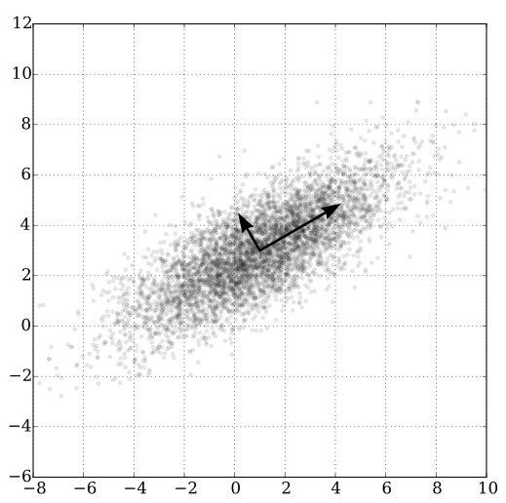
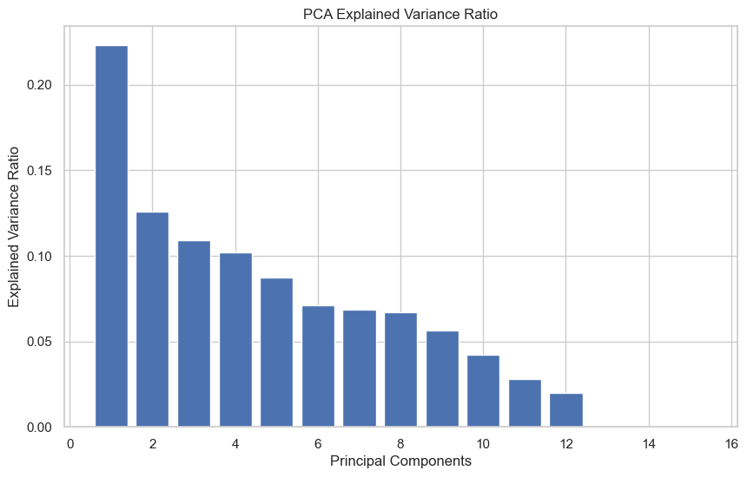
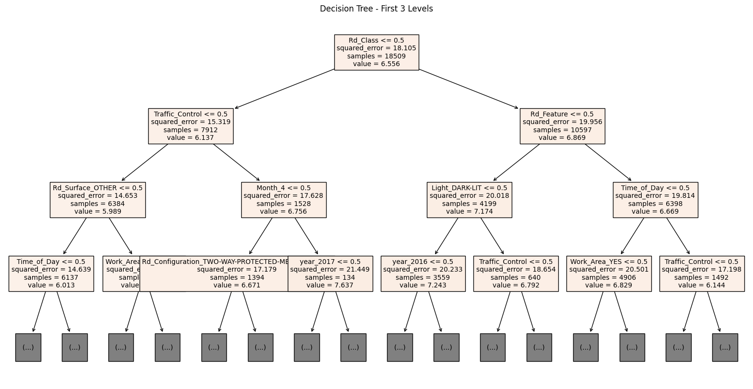
Algorithms
Principal Component Analysis(PCA)
Generalized Linear Models(GLM)
Decision Tree
Notes:
To study the dataset and achieve our goal of finding out most vital variables, we’ll be using 3 different algorithms.
We’ll be using PCA because it can help transform the complex high dimensional data. It will helps us create and select new and more impactful features. It may also help with dimension reduction for better low dimensional data visualization.
The GLM can be used for regression problems. In our study, by training the model using different set of variables and looking at the Bayesian Information Criterion score, we can find out which features are the most impactful ones.
A regression decision tree is an alternative method of linking predictors to a target variable.It’s known for explainability, but also has the problem of overfitting and might not be suitable for regression problems. We’ll get into the details about the 3 algorithms in the following slides

Slide 5
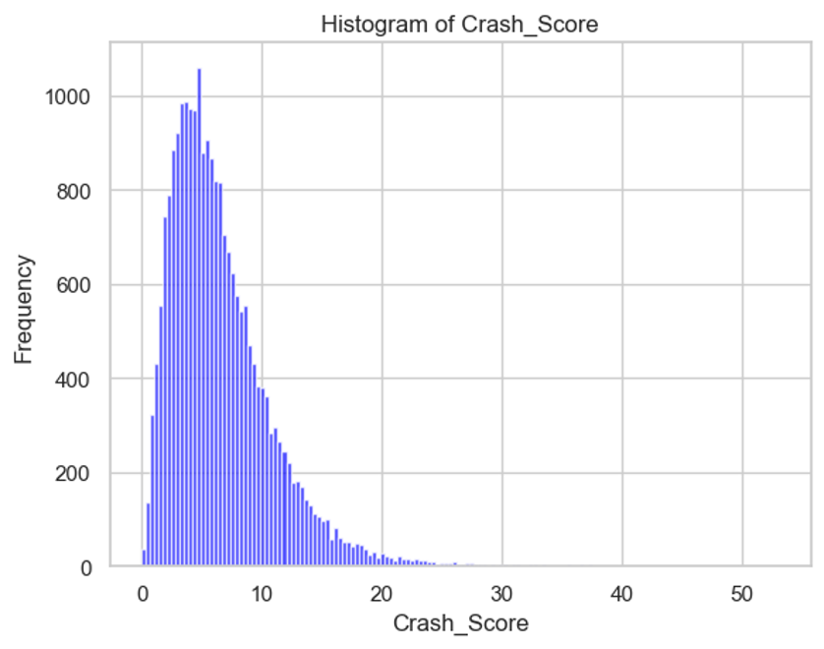
Step 1: Explore variables
Median: 5.66
Mean: 6.57
Max: 53.07
Distribution of the target is skewed to the right. Thus, we choose to plot the log of the target variable for the rest of the presentation.

Slide 6
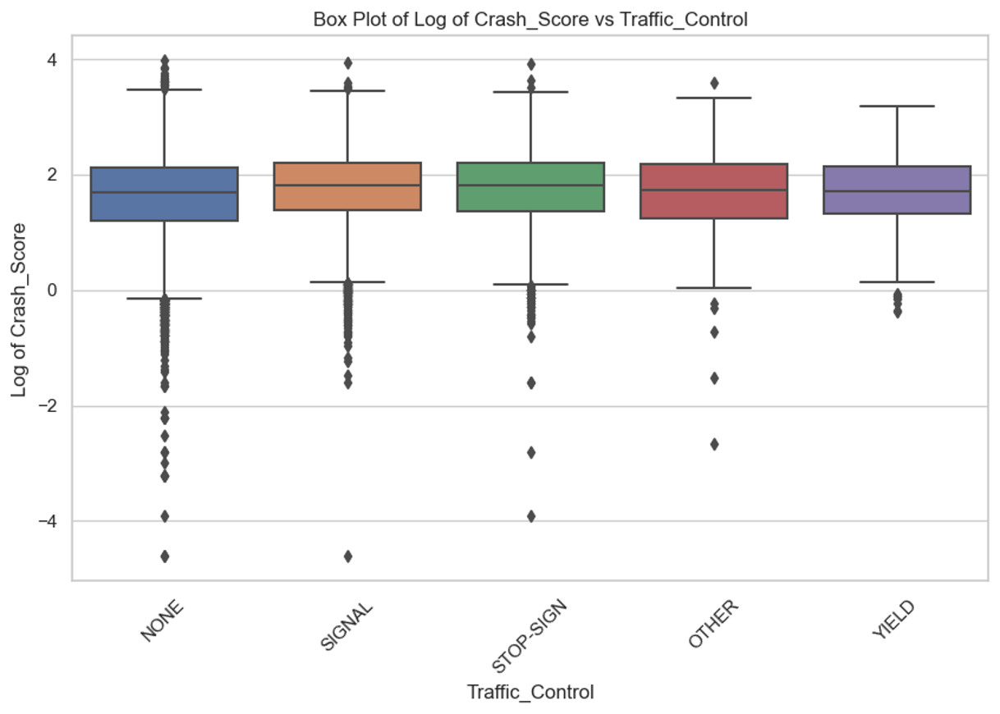
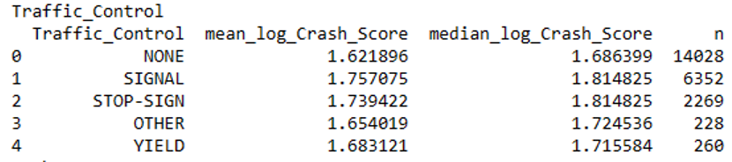
Crash_Score VS Traffic_Control
High for SIGNAL and STOP‐SIGN
Low for YIELD and NONE
Looking at means and medians for the logarithms of crash scores reveals some other possible relationships beyond those already mentioned
It appears there are several variables that may predict the target variable, but none stand out as making large differences.

Slide 7
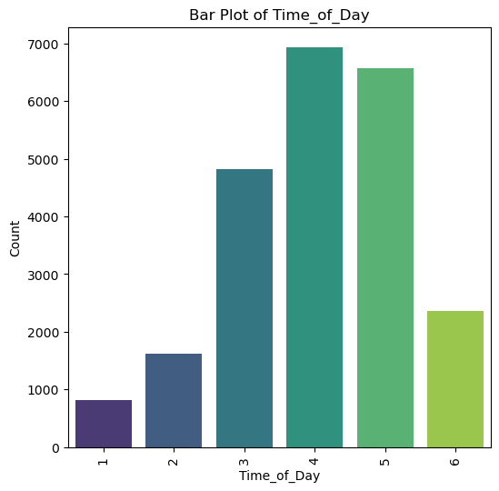
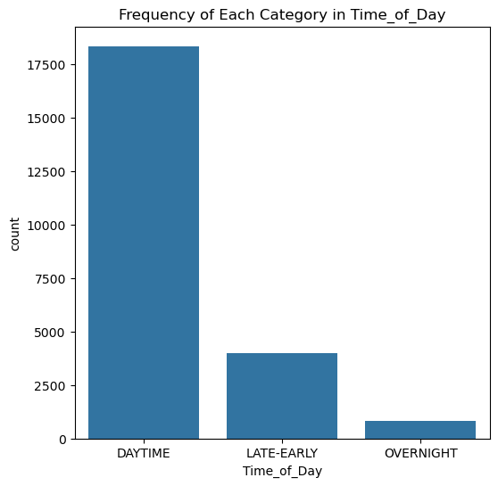
Step 2: Reduce the number of factor levels
For several variables, we merged certain variables where appropriate

Slide 8
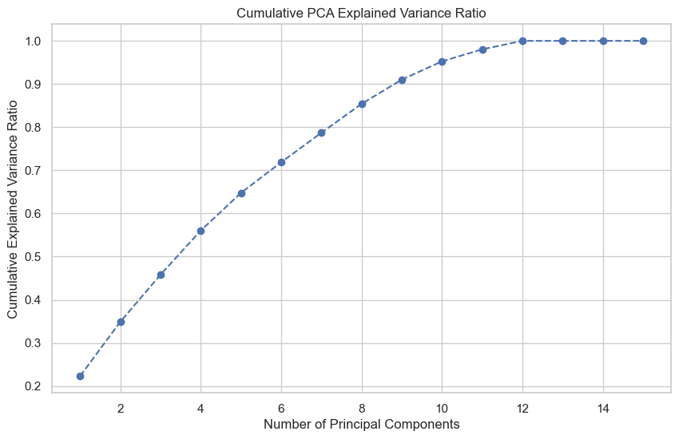
Step 3: Feature Creation via PCA
Only 22% of variation is explained by the first principal component (PC).
35% of variation is explained by the first two PCs.

Slide 9
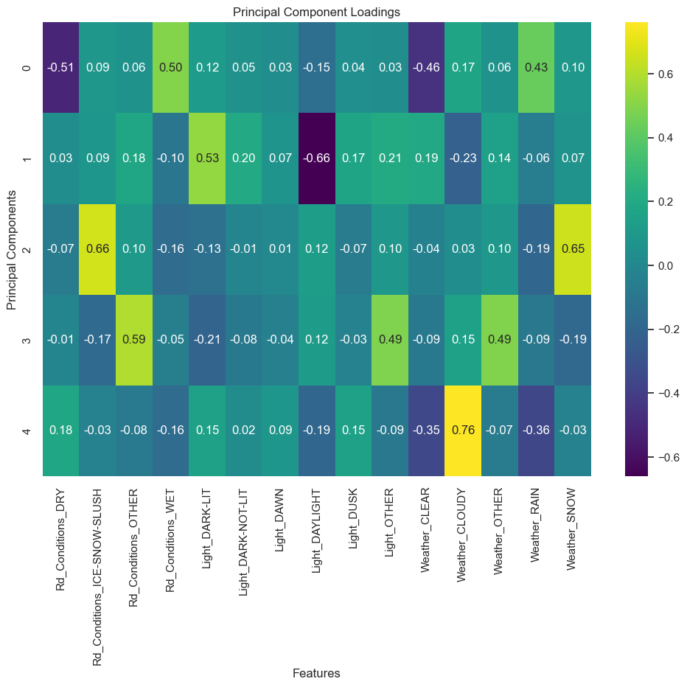
Principal Component Loadings
The largest loadings on the first PC are:
Rd_ConditionsDRY: ‐0.51
Rd_ConditionsWET: 0.50
WeatherCLEAR: ‐0.46
Weather RAIN: 0.43
Applying these weights creates a variable that is strongly positive for rain/wet conditions and negative for dry/clear conditions.
Thus, new feature “WETorDRY” is created.

Slide 10
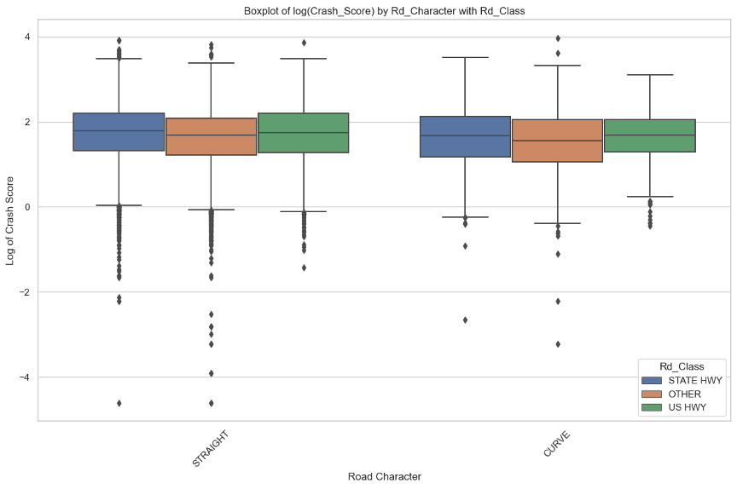
Step 4: Select an interaction
Whether STRAIGHT or CURVE the effect of Rd_Class is the same.
No interaction here

Slide 11
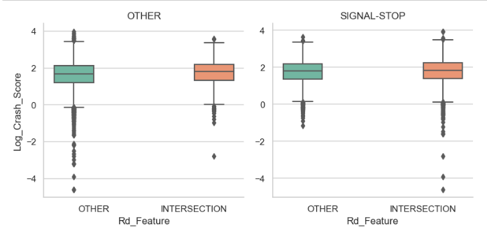
Step 4: Select an interaction
When traffic is controlled, intersection and other then have very similar effects.
When traffic is not controlled, intersections have higher Crash Score.
We plan use this one for future work. It will be good to understand what is going on at intersections without signals or stop signs.

Slide 12
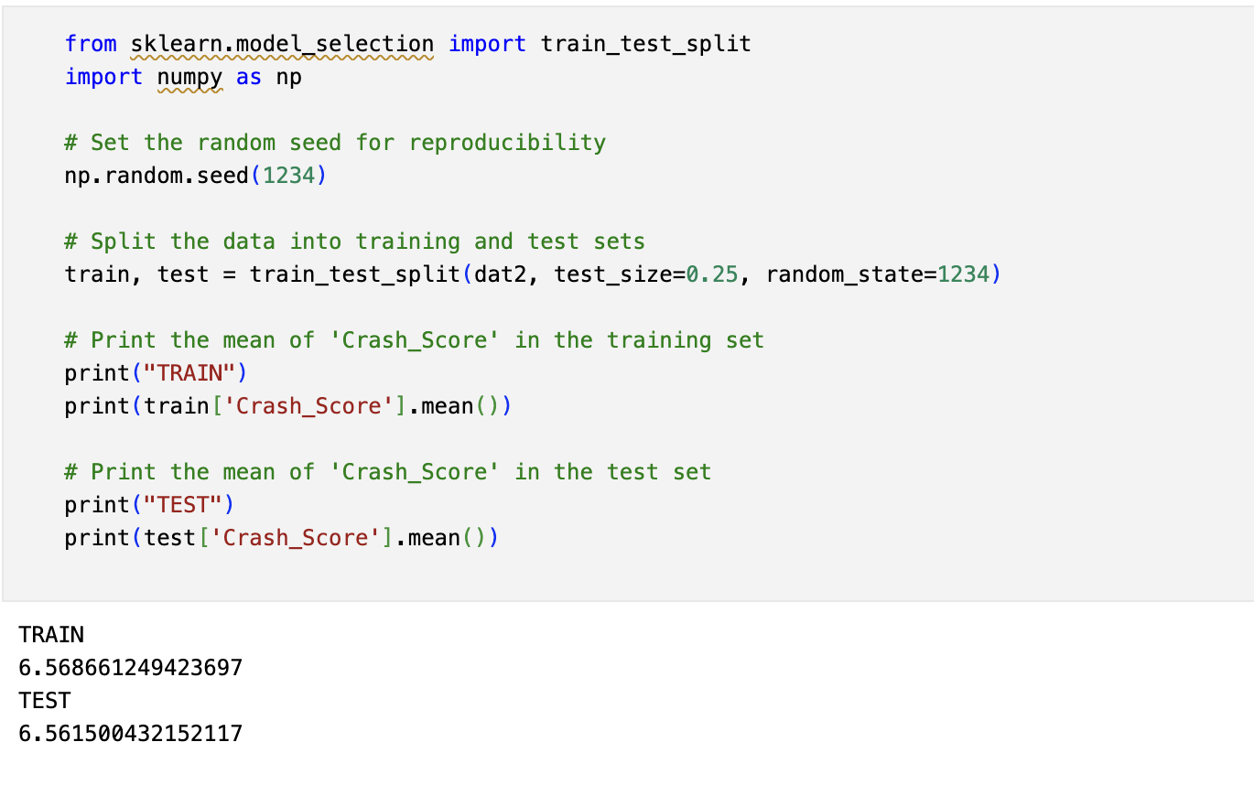
General Linear Model (GLM)
Variable “year” is removed
Variable “month” is converted to a factor variable instead of linear.
Data is split into training (75%) and testing (25%) sets.
Average target value - Consistent
Training set: 6.562
Testing set: 6.583

Slide 13

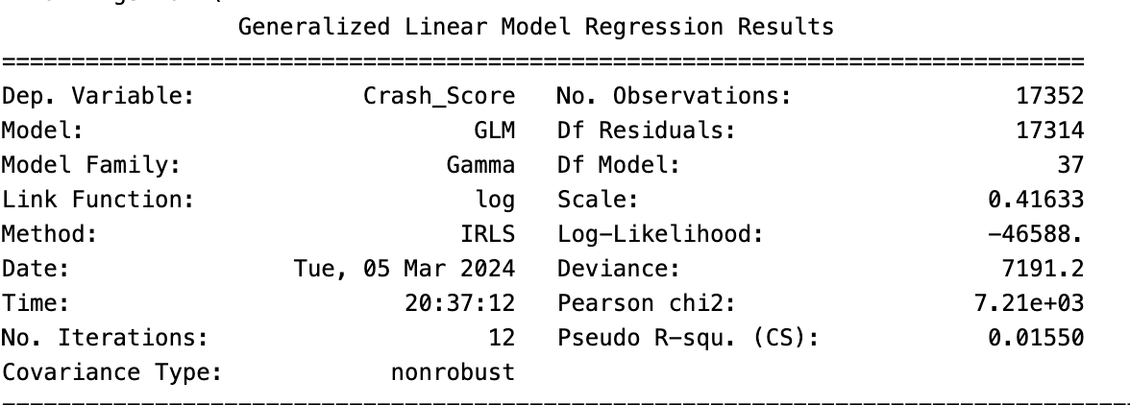
GLM Model Comparison
Gamma distribution
AIC = 93253.2
RMSE = 4.27775
Inverse Gaussian distribution
AIC = 104506.7
RMSE = 4.27742
Normal distribution
AIC = 99430.9
RMSE = 4.27765
lower AIC indicates larger log likelihood, thus the model fits better to the training data.
*Log link is used for all models

Slide 14
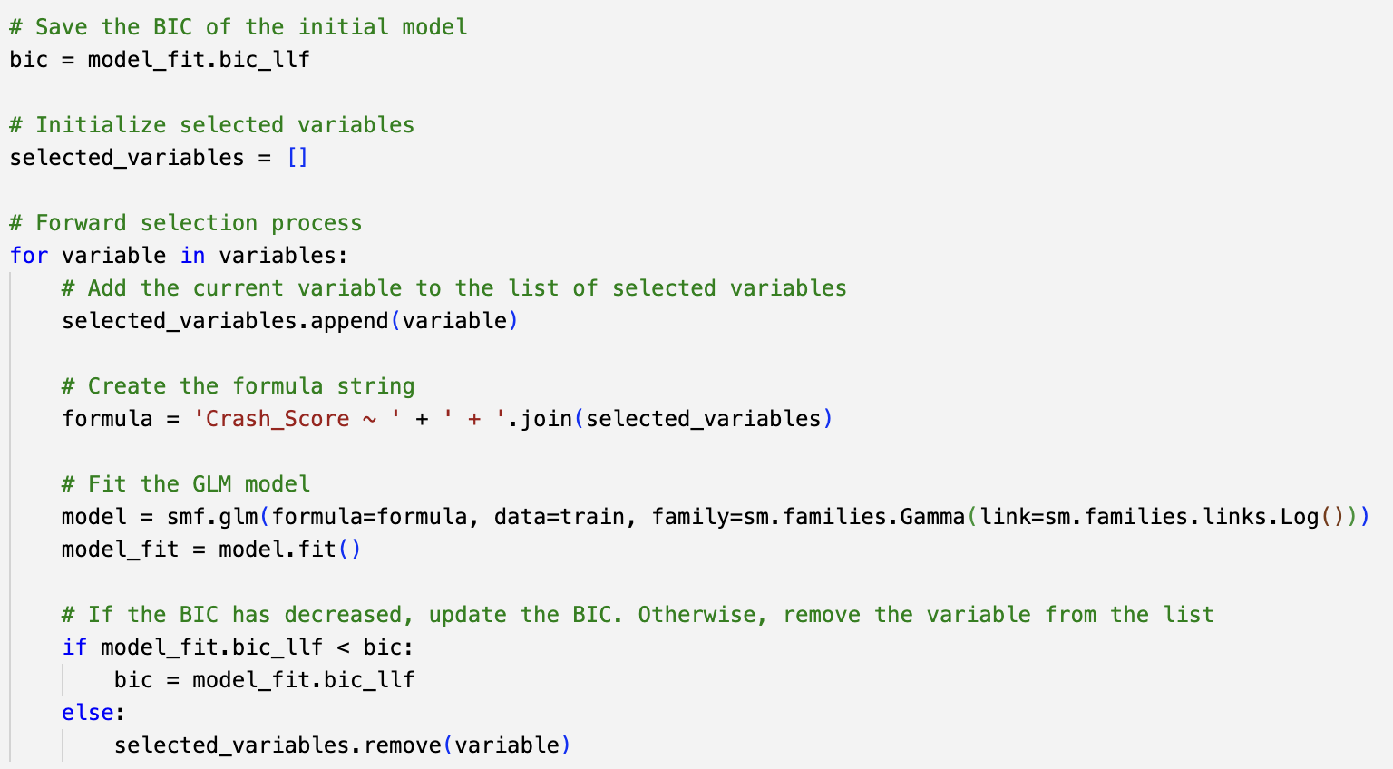
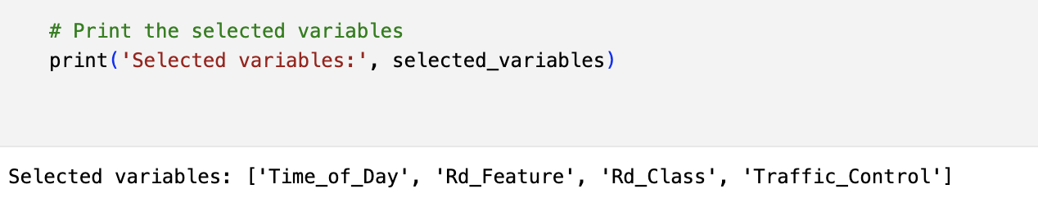
AIC VS BIC
AIC
Adding a variable requires an increase in the log likelihood of two per parameter added.
BIC
The required per parameter increase is the logarithm of the number of observations.
For this problem, the training dataset it is log(17,354) = 9.76 per parameter. Thus, BIC is a more conservative approach as there is a greater penalty for each parameter added, requiring more evidence to support additional variables.
BIC makes the most sense for this analysis.
Notes:
BIC is a more conservative approach as there is a greater penalty for each parameter added, requiring more evidence to support additional variables. Our goal in this project is to identify the key variables that relate to the target variable. As such, it makes sense to take a conservative approach and work with as few variables as necessary. Thus, BIC makes the most sense for this analysis.

Slide 15
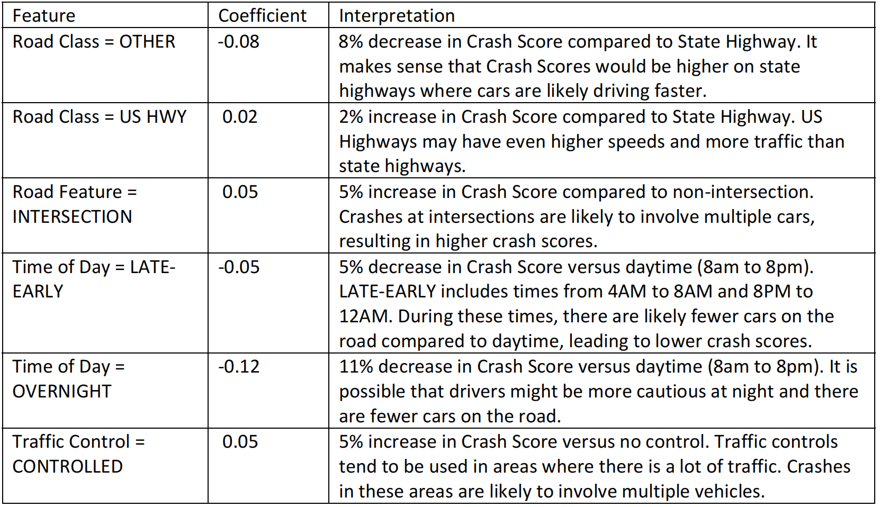
Final Model: BIC & Forward Selection
With BIC, we get 4 important features: time_of_day, rd_feature, rd_class, traffic_control.
The selected variable are used to create a new model.
AIC: 93242.2
RMSE: 4.27869

Slide 16
Decision Tree
Advantages
Easier to interpret
Categorical data is automatically handled
produce non‐linear relationships between variables and the target
Disadvantages (relative to GLMs)
Be easier overfitting to the training set, even with pruning.
When underlying data changes, break points for decision trees can change significantly
We did:
75-25 split for train & test
Regression model instead of classification

Slide 17
Test Result
*Model is evaluated with R^2 score after training
Train score: 0.49355882198473155
Test score = -0.4828254641018883
Score is poor, the model is overfitting right now
Notes:
Once the model is trained, it is evaluated on the same training set to see how well it performs. The evaluation uses the R^2 score method, which returns the coefficient of determination of the prediction, Here the result is 0.5, which means that 50% of the variance in the target variable can be explained by the features in the model.
The visualization provided shows the first 3 levels of the decision tree, giving an insight into the model's decision-making process. Each node represents a decision based on one of the features, leading to branches and ultimately to leaf nodes representing the predicted outcomes. The value in a decision tree is the criteria that helps the tree to classify each new example:

Slide 18
Optimization Attempts
Pruning: Limit the growth of the tree to prevent it from becoming overly complex.
Train_score_pruned = 0.02253
Test_score_pruned = 0.00112
Cross-validation for optimal model parameters:
max_depth: 5
min_samples_leaf: 2
min_samples_split: 2
After both attempts, our score of R^2 is still pretty low:
Best score = 0.00540
Notes:
When fitting a single tree, the locally greedy algorithm is unlikely to find a globally optimal tree. We explored some specific adjustments:

Slide 19
Random Forest and Gradient Boosting
Random Forest
Train_score_rf = 0.43584
Test_score_rf = -0.15938
Gradient Boosting
Train_score_gb = 0.03295
Test_score_gb = 0.00507
Conclusions:
Decision trees are not suitable for regression on this dataset compared to GLM.
Probable cause for bad performance: The decision tree is not similar to the process of generating the Crash-score itself, and the effect of each feature on the Crash-score is ambiguous.

Slide 20
Questions?

